Slide 1
NETS
A net signifies a connection from one circuit unit to another. Such a net carries the value of the signal it is connected to and transmits to the circuit blocks connected to it
If the driving end of a net is left floating, the net goes to the high impedance state
A net can be specified in different ways
wire: It represents a simple wire doing an interconnection. Only one output is connected to a wire and is driven by that
tri: It represents a simple signal line as a wire. Unlike the wire, a tri can be driven by more than one signal outputs
Functionally, wire and tri are identical

Slide 2
VARIABLE DATA TYPE
A variable is an abstraction for a storage device
It can be declared through the keyword reg and stores the value of a logic level: 0, 1, x, or z
A net or wire connected to a reg takes on the value stored in the reg and can be used as input to other circuit elements
But the output of a circuit cannot be connected to a reg
The value stored in a reg is changed through a fresh assignment in the program
time, integer, real, and realtime are the other variable types of data

Slide 3
STRENGTHS AND CONTENTION RESOLUTION
In practical situations, outputs of logic gates and signals on nets in a circuit have associated source impedances
When the outputs of two gates are joined together, the signal level is decided by the relative magnitudes of the source impedances
Sometimes a disparity between the impedances is intentionally introduced to minimize circuit hardware
Effects of such differences in the impedances are indirectly introduced in design descriptions by assigning “strengths” to specific signals
Signal strength declarations are of two types –
Those associated with outputs of gate primitives and
Those with nets

Slide 4
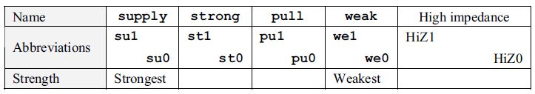
STRENGTHS OF GATE PRIMITIVES
Strength levels associated with outputs of gate primitives
Table 1 gives the names associated with strengths, respective abbreviations, and their order by weight
These hold good for logic 1 state as well as the 0 state
Table 1 Strength levels associated with outputs of gate primitives

Slide 5
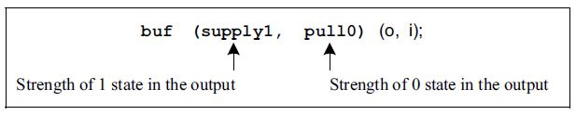
STRENGTHS OF GATE PRIMITIVES –CONT’D
The strengths associated with the output of a gate primitive can be specified separately for the two logic levels
The format for the same is shown in Figure 1 for a specific case
The format remains the same for all types of gate primitives
Figure 1 Format for specifying strengths in the instantiation of a gate primitive

Slide 6
STRENGTH CONTENTION IN GATE PRIMITIVES
When two signals of opposite polarity and differing strengths drive a line, the output status is decided by the stronger signal
However, if the signals are of equal strength, the output is indeterminate. Different contention possibilities arise here

Slide 7
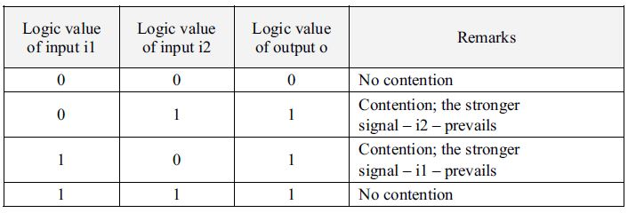
STRENGTH CONTENTION IN GATE PRIMITIVES --CONT’D
Example 1 : Strength Contention
Consider the module in Figure 2. The logic levels taken by the signal o for different combinations of inputs to the two buffers g1 and g2 are shown in Table 2
Contentions of signals with other combinations of levels can be resolved in the same manner
Table 2 Outputs for different inputs for the example of Figure 2

Slide 8
STRENGTH CONTENTION IN GATE PRIMITIVES –CONT’D
Example 1 : Strength Contention –Cont’d
module contres(o,i1,i2);
input i1,i2;
output o;
buf(supply1,pull0)g1(o,i1), g2(o,i2);//note that the same net is driven //by both the gates.
endmodule
Figure 2a A module to illustrate strength contention

Slide 9
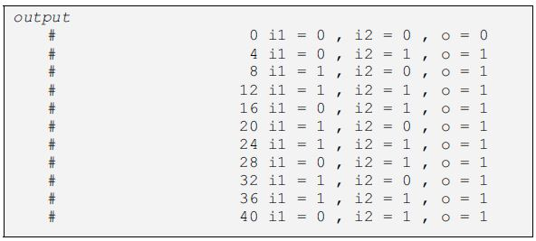
STRENGTH CONTENTION IN GATE PRIMITIVES –CONT’D
Example 1 : Strength Contention --Cont’d
module tst_contres; //TEST BENCH
reg i1,i2;
contres cc(o,i1,i2);
initial
begin
i1 =0;
i2 =0;
end //no contention
always
begin
#4 i1 =0; i2 = 1; // contention; the stronger
#4 i1 =1; i2 = 0; // signal prevails.
#4 i1 =1; i2 = 1; //no contention.
end
initial $monitor($time,"i1=%b,i2=%b,o=%b",i1,i2,o);
initial #40 $stop;
endmodule
Figure 2b The test bench and simulation results
are also shown in the figure

Slide 10
STRENGTH CONTENTION IN GATE PRIMITIVES –CONT’D
Example 1 : Strength Contention –Cont’d
The outputs for the four input combinations are given in the table
Whenever there is a contention, the logic value of the output is decided by the stronger signal
In fact the design description here realizes an OR gate at the output side without additional hardware

Slide 11
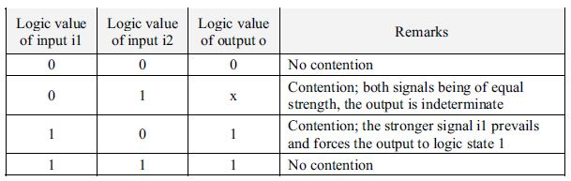
STRENGTH CONTENTION IN GATE PRIMITIVES –CONT’D
Example 2 : Strength Contention
Consider the Example 2, which is a slightly modified version of Example 1
The gate outputs are decided by following, the same logic as in the last case
However, in one case — when both gates “drag” the output with equal strength in opposite directions — the output logic level is indeterminate — that is, x
Table 3 Outputs for different inputs in the example of Figure 3

Slide 12
STRENGTH CONTENTION IN GATE PRIMITIVES –CONT’D
Example 2 : Strength Contention –Cont’d
module contres1(o,i1,i2);
input i1,i2;
output o;
buf(strong1 ,pull0)g1(o,i1);
buf(pull1,pull0)g2(o,i2);
endmodule
Figure 3a Illustration of strength contention resulting in x-type output

Slide 13
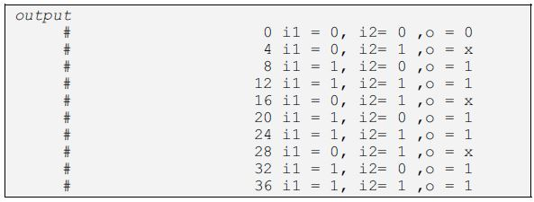
STRENGTH CONTENTION IN GATE PRIMITIVES –CONT’D
Example 2 : Strength Contention –Cont’d
module tst_contres1; //TEST BENCH
reg i1,i2;
contres1 cc(o,i1,i2);
initial
begin
i1 =0;i2 =0;end //no contention
always
begin
#4 i1 = 0; i2 = 1; //contention between pull0 due to i1 and pull1 due to i2; output is x
#4 i1 =1; i2 =0; //contention; output is 1 since strong1 of i1 prevails.
#4 i1 =1 ;i2 = 1; //no contention.
end
initial $monitor($time ," i1 = %b , i2 = %b ,o = %b “ i1,i2,o);
initial #40 $stop;
endmodule
Figure 3b The test bench and simulation results are also shown in the figure

Slide 14
WAND AND WOR TYPES OF NETS
Strengths on nets can be decided in ways other than a direct declaration also. These offer additional flexibility to the circuit designer
Consider the example of Figure 3 for which the input–output values are shown in Table 3
For the signal input combination i1 = 0 and i2 = 1, signal o is indeterminate
However, it may be made specific in two alternate ways:
wand and wor are two types of net declarations for such contention resolution
wand is a wire declaration, which resolves to AND logic in case of contention
wor is a wire declaration, which resolves to OR logic in case of a contention

Slide 15
ILLUSTRATION OF WAND TYPE NET
Figure 4 shows a design module where the outputs of two buffers drive the same net
The net has been declared to be a wand type, and any contention with the possibility of indeterminate output is resolved according to AND logic.
A testbench and simulation results are also shown in the figure.
The input and output logic values and the nature of contention resolutions wherever it occurs are listed out in Table 4
Contention can be seen to be resolved in two possible ways:
When i1 = 1 and i2 = 0, the stronger signal i1 at the 1 level prevails and o = 1. The contention is resolved according to the strengths
When i1 = 0 and i2 = 1, both signals being equally strong, the value of o is decided according to AND logic

Slide 16
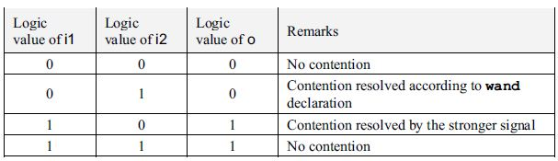
ILLUSTRATION OF WAND TYPE NET --CONT’D
module wand1(i1,i2,o);
input i1,i2;
output o;
wand o;
buf(strong1,pull0)g1(o,i1);
buf(pull1,pull0)g2(o,i2);
endmodule
Table 4 Output values for different inputs of the design in Figure 4
Figure 4a A design module to illustrate use of the wand-type net

Slide 17
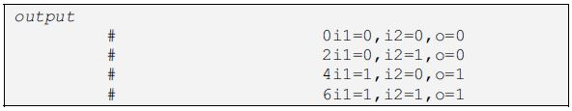
ILLUSTRATION OF WAND TYPE NET --CONT’D
module tst_wand1; //testbench
reg i1,i2;
wand1 ww(i1,i2,o);
initial
begin
i1=0;i2=0; //o =0; no contention
#2i1=0;i2=1; //o =0; contention resolved according to wand declaration
#2i1 =1;i2 =0; //out=1; contention resolved by stronger signal
#2i1 =1;i2=1; //out =1; no contention.
end
initial $monitor($time,"i1=%b,i2=%b,o=%b",i1,i2,o);
endmodule
Figure 4b A test bench and the results of simulation are also shown

Slide 18
ILLUSTRATION OF WOR-TYPE NET
Consider the design segment in Figure 5 with o being declared as a wor type of net instead of a wand type
The corresponding design module is shown in Figure 5a
A test bench and simulation results are also shown in the figure. The outputs for all possible combinations of inputs are given in Table 5
Contention can be seen to be resolved in two possible ways:
When i1 = 1 and i2 = 0, the stronger signal i1 at the 1 level prevails and o = 1. The contention is resolved according to the strengths
When i1 = 0 and i2 = 1, both signals being equally strong, the value of o is decided according to OR logic

Slide 19
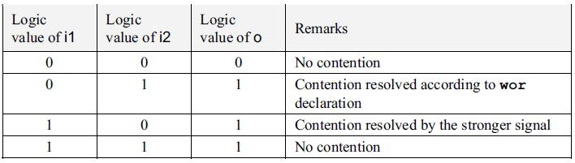
ILLUSTRATION OF WOR-TYPE NET --CONT’D
module wor1(i1,i2,o);
input i1,i2;
output o;
wor o;
buf(strong1,pull0)g1(o,i1);
buf(pull1,pull0)g2(o,i2);
endmodule
Table 5 Output values for different inputs of the design in Figure 5
Figure 5a A design module to illustrate use of the wor-type net

Slide 20
ILLUSTRATION OF WOR-TYPE NET --CONT’D
module tst_wor1; //testbench
reg i1,i2;
wor1 ww(i1,i2,o);
initial
begin
i1=0;i2=0; //out =0 no contention
#2 i1=0;i2=1; //out =1 contention resolved according to wor declaration
#2 i1 =1;i2 =0; //out=1 contention resolved by stronger signal
#2 i1 =1;i2=1; //out =1 no contention.
end
initial $monitor($time,"i1=%b,i2=%b,o=%b",i1,i2,o);
endmodule
Figure 5b A test bench and the results of simulation are also shown

Slide 21
tri
The keyword tri has a function identical to that of wire
When a net is driven by more than one tri-state gate, it is declared as tri rather than as wire
The distinction is for better clarity
Similarly, triand and trior are the counterparts of wand and wor, respectively

Slide 22
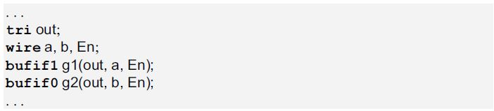
ILLUSTRATION OF tri-TYPE NET
Consider the design segment in Figure 6
Here the signal on net out is controlled by the control signal En
If En = 1, signal a is steered to the net out and the output of gate g2 is tri-stated
On the other hand, if En = 0, signal b is steered to the net out and the gate g1 is tri-stated
If the buffers are controlled by independent Enable signals, the output is resolved according to the respective strengths
Figure 6 A segment of a design to illustrate tri type of net

Slide 23
tri0 and tri1
If the output of a tri-state buffer is to be pulled up to the 1 state when tri-stated, it is declared as net tri1
Similarly, it is declared as tri0 if it is to be pulled down to 0 state when tri-stated
tri0 and tri1 provide respective default outputs and avoid any following circuit having a tri-stated input
In turn, it may manifest as an added load at the concerned gate output

Slide 24
tri0 and tri1 --Cont’d
The example in Figure 7, which shows a design segment, illustrates an application
Table 6 lists the output values of signals considered in the design segment of Figure 7
Referring to the figure and the table, one can see that when En = 0, all three buffers g0, g1, and g2 are off
Net o3, being a wire is tri-stated and is in z state
However, net o1, being of tri0 type, is pulled down to 0 state irrespective of the input value
Net 02, being of tri1 type, is pulled up to 1 state
When En = 1, all three buffers are ON and the respective outputs follow the input
Thus though g0, g1, and g2 are functionally identical, they behave differently due to the difference in the type of the respective output nets

Slide 25
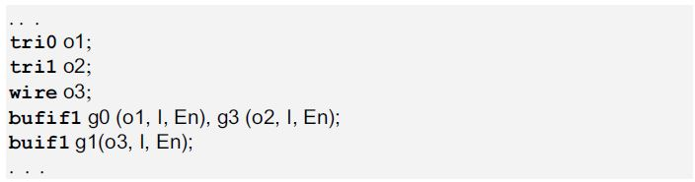
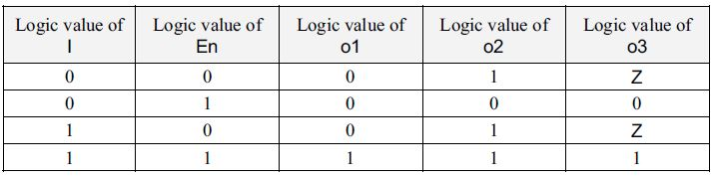
tri0 and tri1 --Cont’d
Figure 7 A segment of a design to illustrate tri0 and tri1 types of net
Table 6 Output values for different inputs of the segment in Figure 7

Slide 26
tri0 and tri1 --Cont’d
Reset, Chip Enable and similar signals can be pulled up or down as required with tri0 or tri1; this signifies the normal status –that is, the chip is disabled or the reset is disabled
As and when the chip is to be enabled, the same is done by enabling the buffer for the required period
Similarly, the reset can be activated for a specified period to reset the chip; subsequently, the reset can be deactivated to restore normal operation of the chip

Slide 27
supply0 and supply1
supply0 and supply1 are the keywords signifying the high- and low-side supplies
Nets to be connected to the Vcc supply are declared as supply1, and those to be grounded are declared as supply0

Slide 28
STRENGTH EXAMPLE
Example
//test.v
module top;
wire a,b;
wire c;
assign (pull1,strong0) a = 1’b0; //////////(1)
assign (pull1,supply0) b =1’b1; //////////(2)
assign #2 c = b; ///////////(3)
assign #1 c = a; ////////////(4)
initial
begin
$monitor($time,"value of c is %v",c);
end
endmodule
In the above example, a has a logic value of ZERO (0) with strength St0 and
b has the logic value of ONE (1) with strength St1

Slide 29
STRENGTH EXAMPLE --Cont’d
Therefore, as the strength value is not specified in statements (3) and (4), c will have the resolved logic value of a and b with default strength - St0, St1, or StX depending upon its logic value
However, if we replace statements (3) and (4) with the following:
assign (pull1, supply0) #2 c = b;
assign (pull1, strong0) #1 c = a;
Then, the strength value of c will depend on the logic value of the RHS, which in this example will be St0

